Slide 1
CS 5/7330
Query Processing (1) –
Storage & File Structures

Slide 2
Query Processing
Big question
Suppose I sent an SQL query to MySQL like:
SELECT id, name
FROM Student, Advise, Instructor
WHERE Student.id = Advise.student_id AND Advise.instructor_id = Instructor.id AND
Advise.department = “CS” AND
Student.gpa >= 3.0
This query tell the database what the answer to be
But does not tell the database how to get the results
The database management system (DBMS) need to figure it out

Slide 3
Query Processing
To figure it out, the DBMS needs to know
How the data is organized
Where the data are
What are the operations involved to retrieve the data
The cost of the operations (so that the DBMS can pick the best one)
We will start with how data are organized

Slide 4
Storage Devices
Two main types of storage
volatile storage: loses contents when power is switched off
non-volatile storage:
Contents persist even when power is switched off.
Includes secondary and tertiary storage, as well as batter-backed up main-memory.
Nearly all database applications will require (at least some) non-volatile storage
Factors affecting choice of storage media include
Speed with which data can be accessed
Cost per unit of data
Reliability

Slide 5
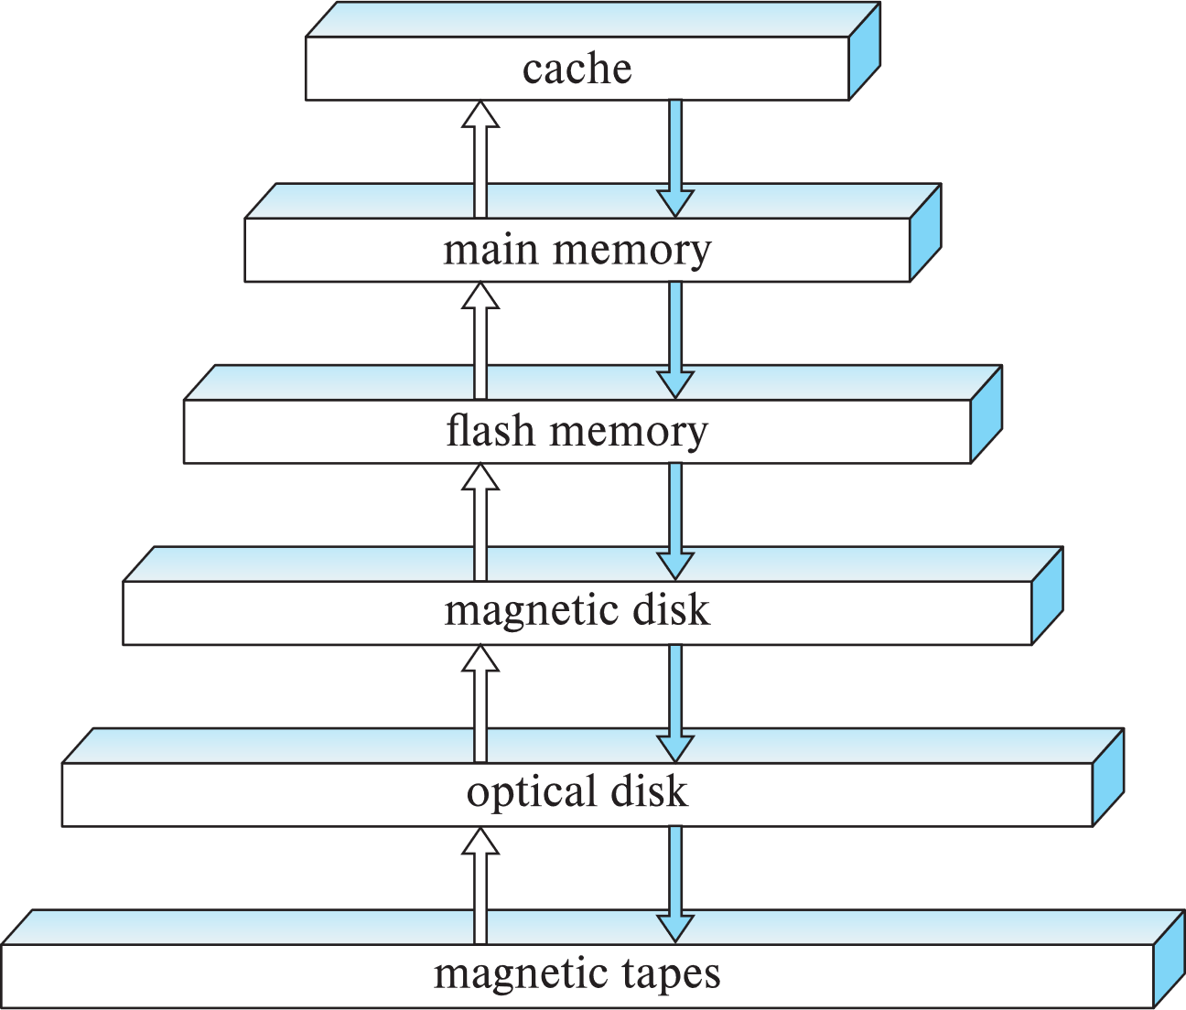
Storage Devices

Slide 6
Storage Devices
primary storage: Fastest media but volatile (cache, main memory).
secondary storage: next level in hierarchy, non-volatile, moderately fast access time
Also called on-line storage
E.g., flash memory, magnetic disks
tertiary storage: lowest level in hierarchy, non-volatile, slow access time
also called off-line storage and used for archival storage
e.g., magnetic tape, optical storage
Magnetic tape
Sequential access, 1 to 12 TB capacity
A few drives with many tapes
Juke boxes with petabytes (1000’s of TB) of storage

Slide 7
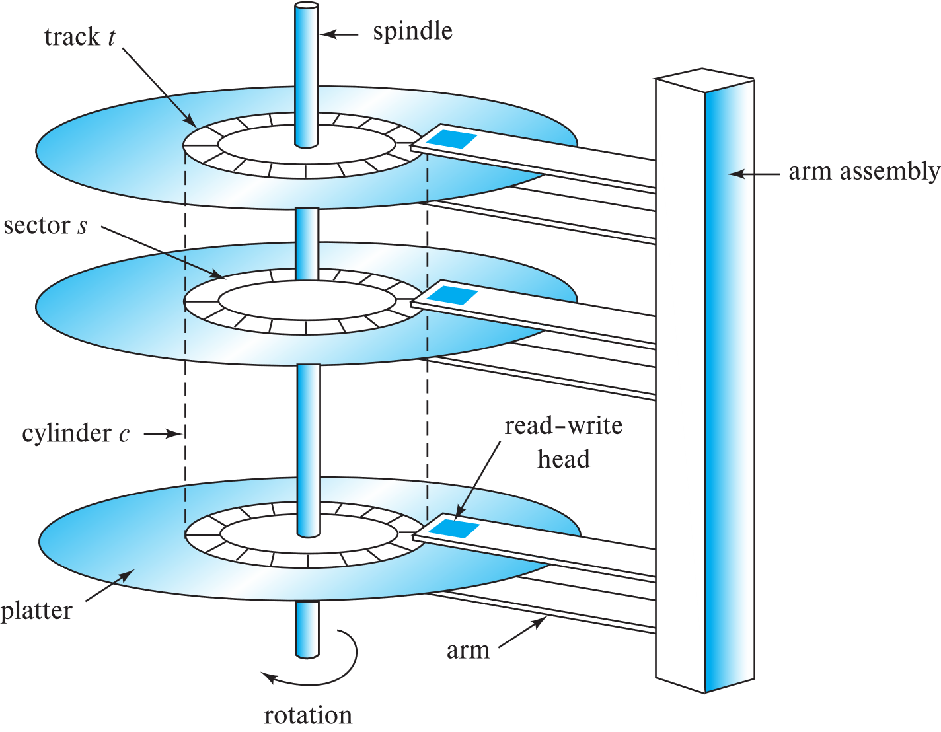
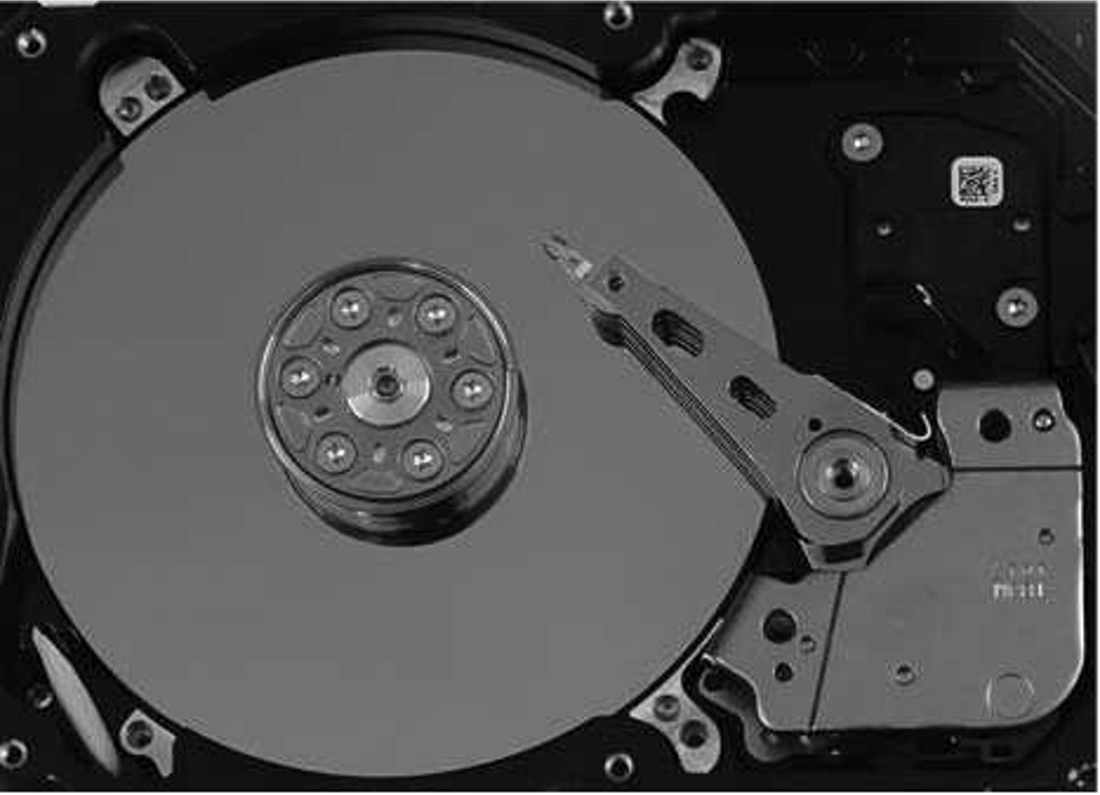
Magnetic Hard Disk

Slide 8
Magnetic Hard Disk
Read-write head
Surface of platter divided into circular tracks
Over 50K-100K tracks per platter on typical hard disks
Each track is divided into sectors.
A sector is the smallest unit of data that can be read or written.
Sector size typically 512 bytes
Typical sectors per track: 500 to 1000 (on inner tracks) to 1000 to 2000 (on outer tracks)
To read/write a sector
disk arm swings to position head on right track
platter spins continually; data is read/written as sector passes under head
Head-disk assemblies
multiple disk platters on a single spindle (1 to 5 usually)
one head per platter, mounted on a common arm.
Cylinder i consists of i^{th} track of all the platters

Slide 9
Magnetic Hard Disk
Disk controller – interfaces between the computer system and the disk drive hardware.
accepts high-level commands to read or write a sector
initiates actions such as moving the disk arm to the right track and actually reading or writing the data
Computes and attaches checksums to each sector to verify that data is read back correctly
If data is corrupted, with very high probability stored checksum won’t match recomputed checksum
Ensures successful writing by reading back sector after writing it
Performs remapping of bad sectors

Slide 10
Magnetic Hard Disk
Access time – the time it takes from when a read or write request is issued to when data transfer begins. Consists of:
Seek time – time it takes to reposition the arm over the correct track.
Average seek time is 1/2 the worst case seek time.
Would be 1/3 if all tracks had the same number of sectors, and we ignore the time to start and stop arm movement
4 to 10 milliseconds on typical disks
Rotational latency – time it takes for the sector to be accessed to appear under the head.
4 to 11 milliseconds on typical disks (5400 to 15000 r.p.m.)
Average latency is 1/2 of the above latency.
Overall latency is 5 to 20 msec depending on disk model
Data-transfer rate – the rate at which data can be retrieved from or stored to the disk.
25 to 200 MB per second max rate, lower for inner tracks

Slide 11
Magnetic Hard Disk
Disk block is a logical unit for storage allocation and retrieval
4 to 16 kilobytes typically
Smaller blocks: more transfers from disk
Larger blocks: more space wasted due to partially filled blocks
Sequential access pattern
Successive requests are for successive disk blocks
Disk seek required only for first block
Random access pattern
Successive requests are for blocks that can be anywhere on disk
Each access requires a seek
Transfer rates are low since a lot of time is wasted in seeks
I/O operations per second (IOPS)
Number of random block reads that a disk can support per second
50 to 200 IOPS on current generation magnetic disks

Slide 12
Magnetic Hard Disk
Example
Consider the following numbers
Seek time = 7 ms
Rotational Latency = 5ms
Data transfer rate = 50 MB per second
Reading one 4KB block
Time = 4K / 50M = 0.078125 ms (1/100 times of seek/rotation)
So reading one block = 7 + 5 + 0.078125ms = 12.078125ms
Reading 10 consecutive blocks same track = 7 + 5 + 10 * 0.078125 = 12.78125ms
Reading 10 blocks on different tracks = 10 * (7 + 5 + 0.078125) = 120.78125ms

Slide 13
Magnetic Hard Disk
Implication
Data that are accessed together should be store “adjacent”
Within the same track at the minimum
Usually means that each table is to be stored in a file
Operating Systems has tools to “defragment” the files
Data that is accessed often should be put into memory
Buffering

Slide 14
Magnetic Hard Disk
Mean time to failure (MTTF) – the average time the disk is expected to run continuously without any failure.
Typically 3 to 5 years
Probability of failure of new disks is quite low, corresponding to a “theoretical MTTF” of 500,000 to 1,200,000 hours for a new disk
E.g., an MTTF of 1,200,000 hours for a new disk means that given 1000 relatively new disks, on an average one will fail every 1200 hours
MTTF decreases as disk ages

Slide 15
Flash Storage
Non-volatile storage
Evolved from EPROM/EEPROM
Each unit is a “gate”
Storage can be set (to 1) by passing electricity to form a second gate in the structure – that is stable
Applying electricity in different way can “erase” the bit and allow it to be rewritten again
Erase first, than rewrite
Two types of flash – NAND and NOR (based on the logic used to set the bit)
NAND bit are cheaper and more scalable as mass storage
However, slower but have to be erased in blocks
Each time a block need to be erased before

Slide 16
NAND-based storage
NAND flash
used widely for storage, cheaper than NOR flash
requires page-at-a-time read (page: 512 bytes to 4 KB)
20 to 100 microseconds for a page read
Not much difference between sequential and random read
Slower than RAM, but faster than the hard disk
Page can only be written once
Must be erased to allow rewrite
Solid state disks
Use standard block-oriented disk interfaces, but store data on multiple flash storage devices internally
Transfer rate of up to 500 MB/sec using SATA, and up to 3 GB/sec using NVMe PCIe

Slide 17
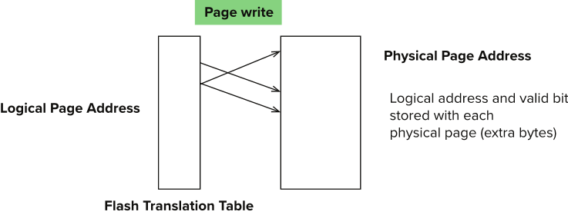
NAND-based storage
Erase happens in units of erase block
Takes 2 to 5 millisecs
Erase block typically 256 KB to 1 MB (128 to 256 pages)
Remapping of logical page addresses to physical page addresses avoids waiting for erase
Flash translation table tracks mapping
also stored in a label field of flash page
remapping carried out by flash translation layer
After 100,000 to 1,000,000 erases, erase block becomes unreliable and cannot be used
wear leveling

Slide 18
NAND-based storage
Random reads/writes per second
Typical 4 KB reads: 10,000 reads per second (10,000 IOPS)
Typical 4KB writes: 40,000 IOPS
SSDs support parallel reads
Typical 4KB reads:
100,000 IOPS with 32 requests in parallel (QD-32) on SATA
350,000 IOPS with QD-32 on NVMe PCIe
Typical 4KB writes:
100,000 IOPS with QD-32, even higher on some models
Data transfer rate for sequential reads/writes
400 MB/sec for SATA3, 2 to 3 GB/sec using NVMe PCIe
Hybrid disks: combine small amount of flash cache with larger magnetic disk

Slide 19
RAID
RAID: Redundant Arrays of Independent Disks
Motivation
Suppose you have a hard disk with a reliability of 90%
You may apply engineering skills to make a more reliable one, but it tends to be expensive.
However, if you take two hard drives with 70% reliability (which will likely be quite a bit cheaper than the first disk) and duplicate the data
Then assuming independence
Probability of failure = (1 – 0.7)² = 0.09
Achieve same reliability

Slide 20
RAID
What other advantage can we have with this set up?
Parallelism (Two process can read the disk at the same time)
Does writing necessarily take longer?
Not necessarily, since we can write in parallel
However, scheduling constraints may affect when one can write
Need extra controller hardware to take care of the problem (not that expensive nowadays)
Any other way that parallelism can help?
What if I request a large amount of data?
How data is spread around the disks are important

Slide 21
RAID
The current main drawback
Storage efficiency is halved
As data is duplicated, you require double the storage
How to get around that problem?
Parity bits
An extra bit that is added to each byte, such that at the end the total number of 1s are even
So when we read a byte + the parity bit, we can check whether there is an error with the byte (assume at most one error)

Slide 22
RAID
The use of multiple disks and make it looks like a single disk to the users
Advantages
high capacity and high speed by using multiple disks in parallel,
high reliability by storing data redundantly, so that data can be recovered even if a disk fails

Slide 23
RAID levels
Various different level proposed
Differs in
Amount of redundancy
How data are distributed through various disks
Basic notion
We assume there are N disks storing data
We will add K disks for redundancy purposes
Notice that N does not have to be equal to K
Various methods of organizing data on the disks (e.g. where to put the redundant data)
We assume chances of 2 disks failing at the same time is very small

Slide 24
RAID levels
We can measure effectiveness of various RAID level in the following way:
Increased Reliability: how much reliability increased
Overhead: How much extra disks are needed (expressed as K/N)
I/O performance: How does I/O perform, do parallelism helps
Different kind of I/O
Short reads/write: reading/writing a few random blocks
Long reads/write: reading/writing a (large) file sequentially
Read-modify-write: read a block, modify the content and then immediately write it back

Slide 25
RAID-0
N disk in parallel
No redundancy
No improvement in reliability
How do parallelism help?
Short read/write: Yes, if data are spread across different disks
Long read/write: Doesn’t help (since file reside on a single disk
Can we do anything about it?

Slide 26
RAID-0
Block Striping
With n disks, block I of a file go to disk (i mod n + 1)
Now long reads can be parallized
Potential N times performance gain
File 1
File 2

Slide 27
RAID-1
N disk of data
Block-level striping (as in RAID-0)
Full redundancy / Mirroring
Every data disk is duplicated
Overhead = 100% (N = K)
How do parallelism help?
In addition to RAID-0
Now each block appear on two disks.
Two requests on the same disk can be served in parallel
As a side benefit, tends to shorten wait queues
Does not hurt writing much: as writing can be done in parallel
Although it is more likely that you have to seek at least one disk (even if in parallel)

Slide 28
RAID-2,3,4
Problem with RAID-1: 100% Overhead
Can we save the overhead
Notice we assume chance of two failures is low
So if we can store enough information to handle one error, that may be good enough

Slide 29
RAID-2
Use Hamming code
Given N bits, one can have an algorithm to add some bits (roughly logarithmic number of bits)
If there is a single error, the Hamming code can determine which bit is the error bit and correct it automatically
Use bit-striping (i.e. the bits of a word is striped across disks)
The hamming code are stored in the extra disk

Slide 30
RAID-3,4
Hamming code is overkill also
If there is an error, usually there is some other means (e.g. look at the hardware) to determine where the error is.
So just need to detect an error
Use parity bit
Given a byte, add either a single 1 or 0 such that at the end the number of 1 bits are even
So now if a byte (+ parity) has odd number of 1s, then there is an error

Slide 31
RAID-3,4
RAID-3: bit-striping
RAID-4: block-striping, each parity is parity of one block on a disk (not across all disk)
Writes are more efficient
Overhead: 1 / N (since one disk only to store the parity bit)
Effeciency:
Reading is fine
Writing can be an issue
The disk holding the parity bit is overhead

Slide 32
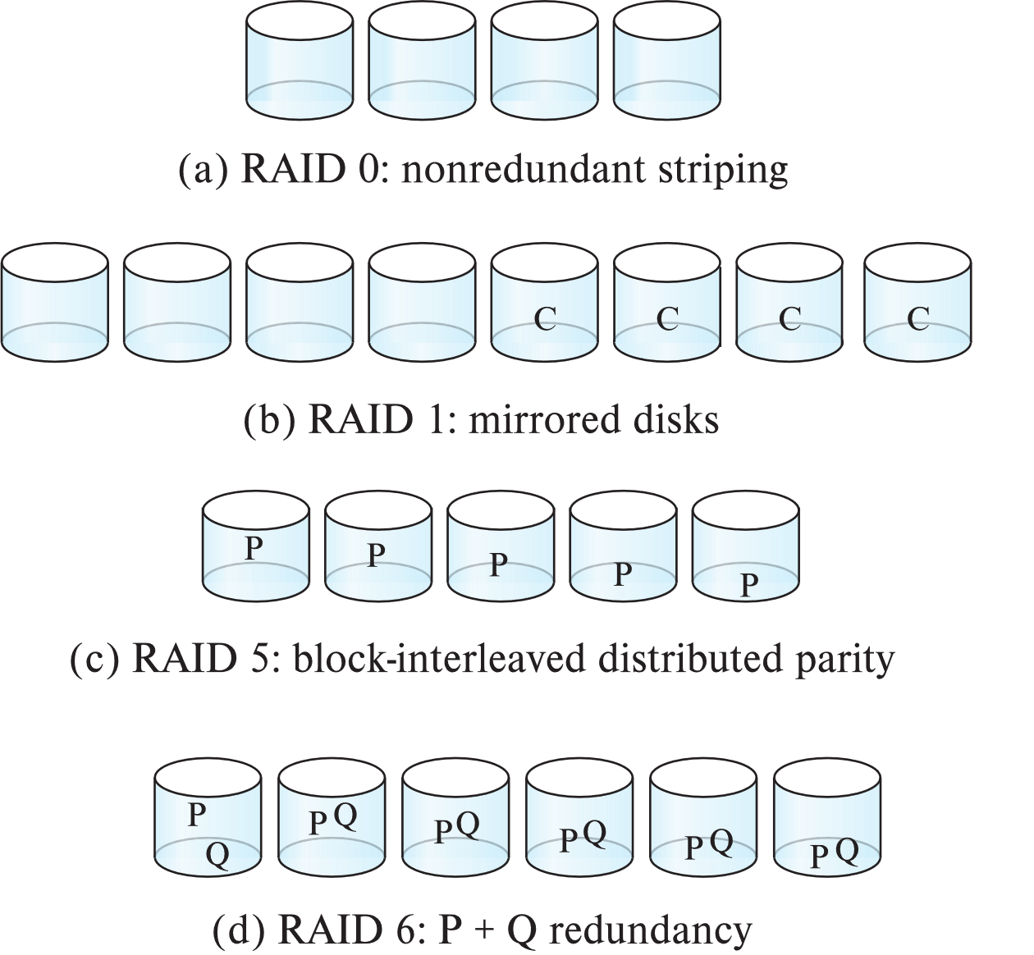
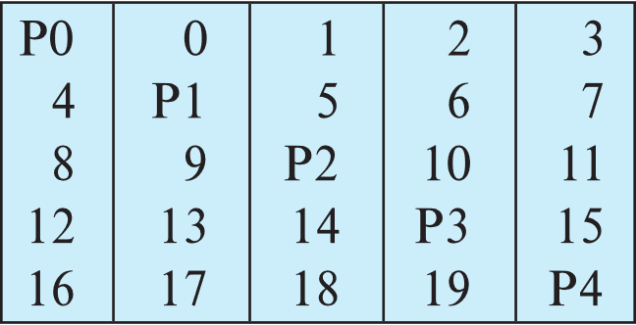
RAID-5
To overcome the bottleneck
Distribute the parity info across all disks

Slide 33
RAID-6
Similar to RAID-5
But store more error correction blocks to help detect more errors

Slide 34
RAID -- Redundancy
Redundancy – store extra information that can be used to rebuild information lost in a disk failure
E.g., Mirroring (or shadowing)
Duplicate every disk. Logical disk consists of two physical disks.
Every write is carried out on both disks
Reads can take place from either disk
If one disk in a pair fails, data still available in the other
Data loss would occur only if a disk fails, and its mirror disk also fails before the system is repaired
Probability of combined event is very small
Except for dependent failure modes such as fire or building collapse or electrical power surges
Mean time to data loss depends on mean time to failure, and mean time to repair
E.g., MTTF of 100,000 hours, mean time to repair of 10 hours gives mean time to data loss of 500*10⁶ hours (or 57,000 years) for a mirrored pair of disks (ignoring dependent failure modes)

Slide 35
RAID -- Redundancy
Redundancy – store extra information that can be used to rebuild information lost in a disk failure
E.g., Mirroring (or shadowing)
Duplicate every disk. Logical disk consists of two physical disks.
Every write is carried out on both disks
Reads can take place from either disk
If one disk in a pair fails, data still available in the other
Data loss would occur only if a disk fails, and its mirror disk also fails before the system is repaired
Probability of combined event is very small
Except for dependent failure modes such as fire or building collapse or electrical power surges
Mean time to data loss depends on mean time to failure, and mean time to repair
E.g., MTTF of 100,000 hours, mean time to repair of 10 hours gives mean time to data loss of 500*10⁶ hours (or 57,000 years) for a mirrored pair of disks (ignoring dependent failure modes)

Slide 36
RAID -- Parallelism
Two main goals of parallelism in a disk system:
1. Load balance multiple small accesses to increase throughput
2. Parallelize large accesses to reduce response time.
Improve transfer rate by striping data across multiple disks.
Bit-level striping – split the bits of each byte across multiple disks
In an array of eight disks, write bit i of each byte to disk i.
Each access can read data at eight times the rate of a single disk.
But seek/access time worse than for a single disk
Bit level striping is not used much any more
Block-level striping – with n disks, block i of a file goes to disk (i mod n) + 1
Requests for different blocks can run in parallel if the blocks reside on different disks
A request for a long sequence of blocks can utilize all disks in parallel

Slide 37
RAID levels
Factors in choosing RAID level
Monetary cost
Performance: Number of I/O operations per second, and bandwidth during normal operation
Performance during failure
Performance during rebuild of failed disk
Including time taken to rebuild failed disk
RAID 0 is used only when data safety is not important
E.g., data can be recovered quickly from other sources

Slide 38
RAID levels
Level 1 provides much better write performance than level 5
Level 5 requires at least 2 block reads and 2 block writes to write a single block, whereas Level 1 only requires 2 block writes
Level 1 had higher storage cost than level 5
Level 5 is preferred for applications where writes are sequential and large (many blocks), and need large amounts of data storage
RAID 1 is preferred for applications with many random/small updates
Level 6 gives better data protection than RAID 5 since it can tolerate two disk (or disk block) failures
Increasing in importance since latent block failures on one disk, coupled with a failure of another disk can result in data loss with RAID 1 and RAID 5.

Slide 39
Hardware Issues
Software RAID: RAID implementations done entirely in software, with no special hardware support
Hardware RAID: RAID implementations with special hardware
Use non-volatile RAM to record writes that are being executed
Beware: power failure during write can result in corrupted disk
E.g., failure after writing one block but before writing the second in a mirrored system
Such corrupted data must be detected when power is restored
Recovery from corruption is similar to recovery from failed disk
NV-RAM helps to efficiently detected potentially corrupted blocks
Otherwise all blocks of disk must be read and compared with mirror/parity block

Slide 40
Hardware Issues (Cont.)
Latent failures: data successfully written earlier gets damaged
can result in data loss even if only one disk fails
Data scrubbing:
continually scan for latent failures, and recover from copy/parity
Hot swapping: replacement of disk while system is running, without power down
Supported by some hardware RAID systems,
reduces time to recovery, and improves availability greatly
Many systems maintain spare disks which are kept online, and used as replacements for failed disks immediately on detection of failure
Reduces time to recovery greatly
Many hardware RAID systems ensure that a single point of failure will not stop the functioning of the system by using
Redundant power supplies with battery backup
Multiple controllers and multiple interconnections to guard against controller/interconnection failures

